Slide 1
Shaping up with ANgularJS
Linh Nguyen Vu

Slide 2
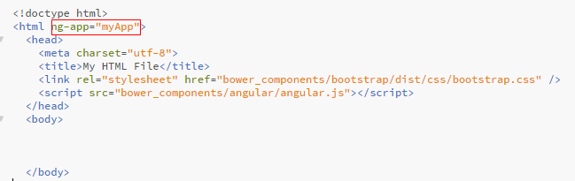
What is AngularJS?
A client-side JavaScript Framework for adding interactivity to HTML.
A Directive is a marker on a HTML tag that tells Angular to run or reference some JavaScript code.

Slide 3
Directives
ng-app − This directive starts an AngularJS Application.
ng-init − This directive initializes application data.
ng-model − This directive defines the model that is variable to be used in AngularJS.
ng-repeat − This directive repeats html elements for each item in a collection.

Slide 4

Modules
Where we write pieces of our Angular application.
Makes our code more maintainable, testable, and readable.
Where we define dependencies for our app
AngularJS
App name
Dependencies
Other libraries we might need.

Slide 5


Expressions
Allow you to insert dynamic values into your HTML
Using double-curlies

Slide 6


Controllers
Controllers are where we define our app’s behavior by defining functions and values.
Attaching the Controller

Slide 7
Understanding scope
view is a projection of the model through the HTML template.
model the data shown to the user in the view and with which the user interacts.
controller the business logic behind views.
A scope is context where the model is stored so that controllers, directives and expressions can access it
https://docs.angularjs.org/guide/concepts

Slide 8

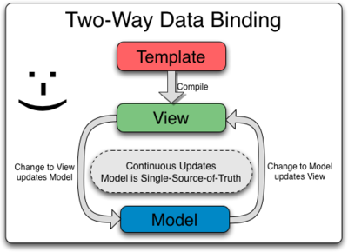
Understanding scope
Model
Name: LinhNV
2 way-binding
https://docs.angularjs.org/guide/databinding

Slide 9
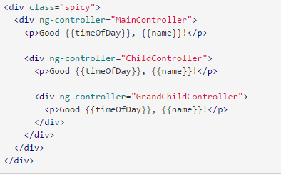
Controller: Scope Inheritance
Scope in another scope: take the closest

Slide 10
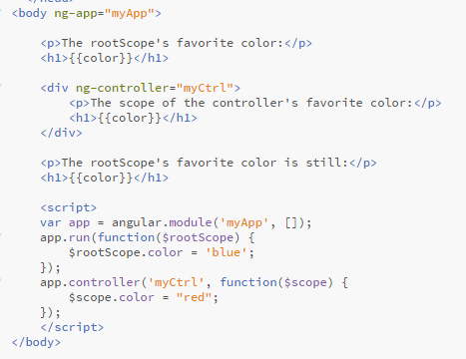
rootScope
All applications have a $rootScope which is the scope created on the HTML element that contains the ng-app directive.

Slide 11
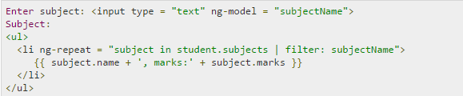
Filter
Sr.No. | Name | Description
1 | uppercase | converts a text to upper case text.
2 | lowercase | converts a text to lower case text.
3 | currency | formats text in a currency format.
4 | filter | filter the array to a subset of it based on provided criteria.
5 | orderby | orders the array based on provided criteria.

Slide 12
HTML DOM
Sr.No. | Name | Description
1 | ng-disabled | disables a given control.
2 | ng-show | shows a given control.
3 | ng-hide | hides a given control.
4 | ng-click | represents a AngularJS click event.

Slide 13
FORM
$dirty − states that value has been changed.
$invalid − states that value entered is invalid.
$error − states the exact error.

Slide 14

Services
a function, or object, that is available for, and limited to, your AngularJS application.
Prefer using built-in Angular services instead of JavaScript
Eg: use $locations instead of window.location
-> use service in controller, filter…

Slide 15
$http – AngularJS Ajax
$http is an AngularJS service for reading data from remote servers.

Slide 16
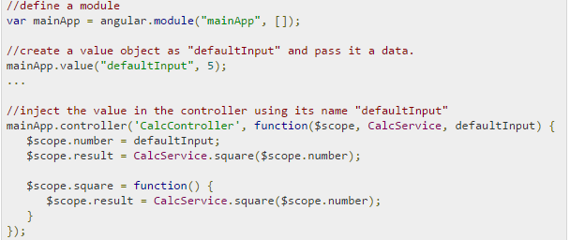
Dependency Injection
Value: simple JavaScript object and it is used to pass values to controller.

Slide 17
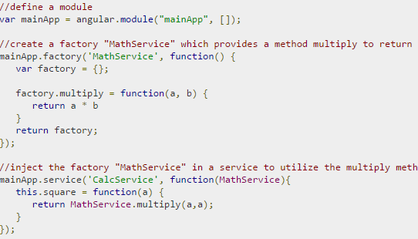
Dependency Injection
Factory: a function which is used to return value. It normally uses a factory function to calculate and return the value.

Slide 18
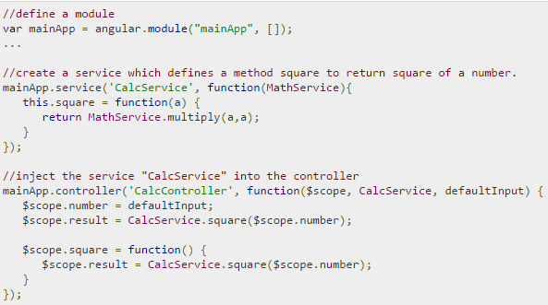
Dependency Injection
Service: a singleton JavaScript object containing a set of functions to perform certain tasks

Slide 19
Gee gee…!

